Slide 1
English For Computer
Computer Concepts

Slide 2
What Is Computer
A computer is a device, that accepts information or data (in the form of digitalized data) and manipulates it for some result based on a program or sequence of instructions on how the data is to be processed.
Programmable machine that can store, retrieve, and process data. The program is read by the computer one instruction at a time, an operation is performed, and the computer then reads in the next instruction, and so on, computer processes continuously
Computers also include the means for storing data (including the program, which is also a form of data) for some necessary purpose and duration
Recently, computers and programs have been devised that allow multiple programs (and computers) to work on the same problem at the same time parallelly. Computer processes jobs multitasking and concurrently

Slide 3
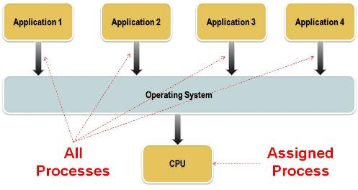
Multitasking Processes
a method where multiple tasks, also known as processes, are performed during the same period of time

Slide 4
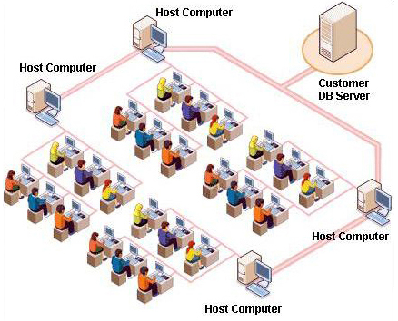
Multi-users Concept
Multi-user is a term that defines an operating system or application software that allows access by multiple users of a computer. Time-sharing systems are multi users systems

Slide 5
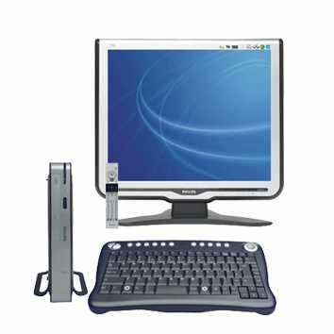
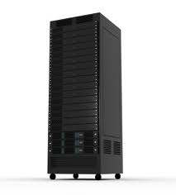
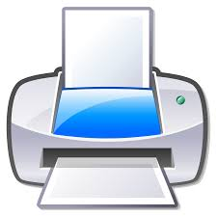
What Is Computer
A device that computes, especially a programmable electronic machine that performs high-speed mathematical or logical operations or that assembles, stores, correlates, or otherwise processes information
Programmable machine that can store, retrieve, and process data
A device that receives, processes, and presents information
Computer is a machine that processes data or facts electronically.

Slide 6
… computer
It is only a tool which ……(by definition)
  Accept digitalized information or data, to be..
  Processed or manipulated electronically, for
  Presenting results in a various form
Computer conducts data processing, in a series of :
  Collecting a data (input)
  Processing or manipulating or handling collected data (process)
  Delivering report or information for a particular purposes
Electronic Data Processing, therefore, is the collection, manipulation and distribution of facts – by electronic means (by computer)
The Data Processing Cycle is : Input – Process - output

Slide 7
Data vs Information
Data
  Facts that are being input into computer
  Raw facts or figures,
  Arranged in such a way that can be accepted and processed by computer
  Meaningless
Information
  Data that has already been processed by computer
  Change to be a useful information
  Comes out from process as an output
  Meaningful
The purpose of the computer and Data Processing is to process data so that they become more useful information

Slide 8
The form of Data
In order to be processed by computer, :
  Data must be machine readable
  Expressed in the numeric code (digital)
  Computer will transforms all data into its own systems (language) so that the data can be processed,
The hierarchy of organizing data is :
  Field the smallest unit of data, contains one unit of data
  Record, is a collection of a set individual fields combined together
  A file, a combination of a group of related records
  Database, a large collection of files

Slide 9
Characteristics of Computer process
Accuracy
  Computers not only process data, but they process data accurately
  It is because electronic circuit never fail
  If there is a failure, it must not be due to electronic circuit
  Expressed in the numeric code (digital)
Fast
  The ability of computer to process data is very high in speed
  Already in nano second (one billionth of a second)
  In the near future, the speed will have been moved to a picosecond (one trillionth) of a second, especially in a big computer (mainframe)

Slide 10
Programs
Computer is only a tool,
  they perform what people instruct,
  they could not think themselves
In order to perform its function, they must receive instruction that control the input, the process as well as the output information. Things to do this is a computer program
A computer program is a specific set or series of instructions that tells the computer what to do
Programs are not part of the computer.
Programs must be put (installed) into the computer along with data for processing take place
Programs, or software can be developed in many different computer language

Slide 11
Computer Operations
All type of computer (small, medium or large), has similar basic processing cycle – Input-Process-Output
Need an operations that computer are able to perform its capability
The operations can be classified into 3 basic types
  Input and output operation (accepting input and delivering output)
  Arithmetic operations (add, subtract, multiply, dividing number)
  Logical operations (comparing)
With only these type of operations computer can quickly and accurately perform six major functions as storing, calculating, comparing, classifying, sorting and summarizing

Slide 12
The Computer Systems
Computer systems consist of 3 basic parts :
  Input Unit
  A Processing unit
  Output unit
Input unit accept both data and program needed for process and present them to the processor unit
Output unit display the results obtained from processing
The processing unit, which both stores and processes data, has 2 main tasks :
  Central processing unit
  Main storage unit
  In addition, most computers also have some auxiliary or extra storage

Slide 13
Summary
Computers are only a tool or devices that process data quickly and accurately
Regardless the size, cost or appearance, all computer :
  Have similar computer basic processing cycle,
  Are made up of the same basic parts
  Perform the same type of operations
In spit of their capabilities, all computers :
  need direction from people
  Directed by human creativity and imagination
The use of computers will continue to develop, making these machine more valuable in the future

Slide 14
IT Organization
The structure of an IT organization is absolutely fundamental to the success of that organization.
It provides the foundation for and sets the tone and tenor for all else IT that follows.
Being traditionally under IT HR’s purview, CIO’s/CTO’s often spend a good deal of time with them as regards the best layout of their IT team.

Slide 15
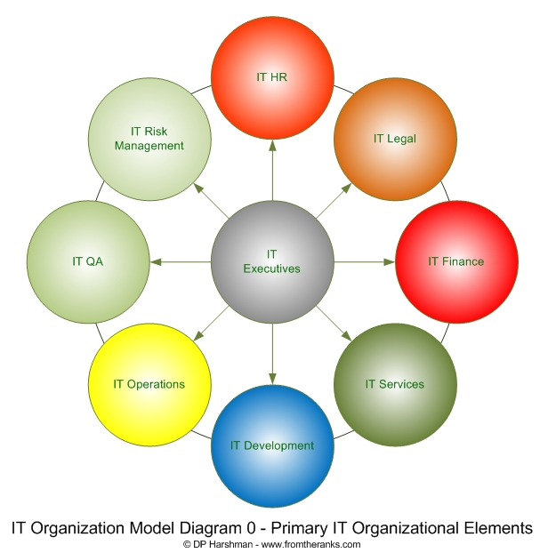
Fundamental Element in IT Organization

Slide 16
IT Functions
IT three main area functions :
  IT Business Development
  Develop IT based business, R&D and define the application areas need to be computerized
  Application Development
  Develop, provide and maintain application programs needed by the company
  Infrastructure & Operation
  Provide, maintain and operate hardware, network and operation

Slide 17

IT Organization
IT Director
GM IT
DGM Bus Dev
DGM Dev
DGM Operation
UL & BA
Core App
Data Center
R & D
Surr App
Help Desk
SOP& Training
Switching App
NW & Syst Supp

Slide 18
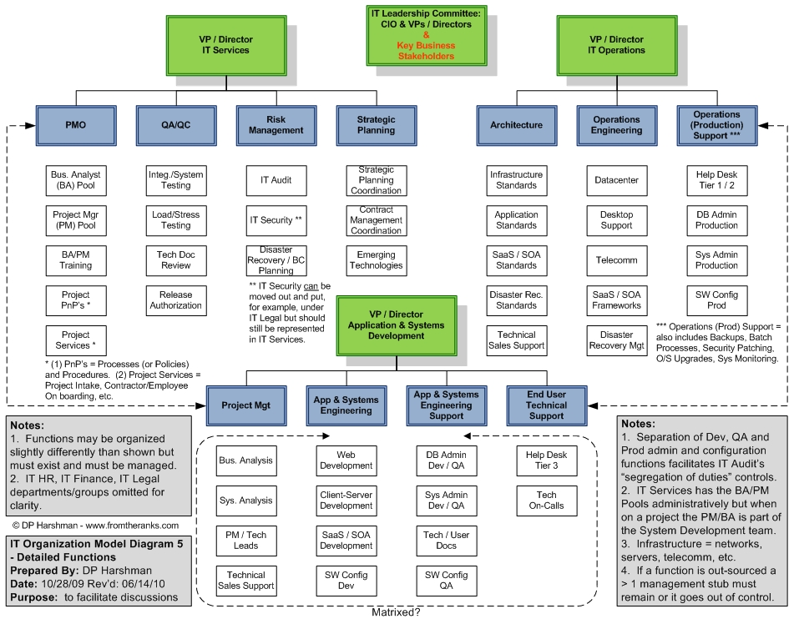

Slide 19
IT Organization
The Implementation in a company depends on the size and the complexity of the IT services
The developer and the operator must be clearly separated
IT compliance unit also need to be set as independence IT unit.
IT budget and Planning also need to be define in relation with the size of the budget
The Organization derives a lot of careers in IT

Slide 20
Careers in Data Processing
Data processing area offer opportunities for interesting careers
Several types of jobs are common to the field of data processing in individual, small, medium or large corporation
Areas of Data processing :
  Development area
    System Analyst, is a computer professional who design and develop all the system which will be used on a particular computer system. He analyzes, plans, designs, tests and implements applications
    Programmer – is a computer application developer who develops and encodes program base on the system and program specification developed by system analyst
      System Programmers, writes program for the system operation; and much more deals with machine language
      Application programmers, write an application program to solve the problems analyzed by systems analyst

Slide 21
Careers in Data Processing
  Operation
    Computer Operators; operates and maintain computer to continuously operates during the services
    Computer technicians (computer engineer), installs and maintains computer hardware to be in full operation.
    Network Operators; operate and maintain computer network and connectivity among all computers
    Network technicians; develops and implements network and security design
  Support
    Quality assurances (system analyst & Programmers); evaluate and test all system designed by developer and conduct user acceptance test with the user
    Data Librarian; administers and keeps all company softcopy file
    Business development; develops computer application to help users find and solve the computer problems

Slide 22
Careers in Data Processing
  Others
    IT Consultant (Application Development, System Integrator, Network & Communication, IT Blueprint, IT Audit etc)
    IT Sales & Services
    IT Technical Support & Maintenance
    IT Development & Training
    IT Outsourcing
    Communication and it’s related business
    IT Security
    Etc

Slide 23
Computer Types

Slide 24
The Computer Types
Basically there are two basic types of computer :
Analog Computer
The function is to measure, to represent number (measuring electricity, temperature etc)
Digital Computer,
The basic idea is to count, by using a series of digits
Hybrid Computer, (analog and digital)
Most current computers are digitally
More accurate
Faster
Cheaper
Better performance

Slide 25
The Computer Types
Analog Computer
Computer that uses continuous-changeable aspects of physical phenomena such as electrical, mechanical, or hydraulic quantities to model the problem being solved.
Developed from the transistor technology
Commonly used before the digital technology developed sufficiently
Current-ly they have moved to digital technology
Usually is used to solve a non-analytical differential equation problem, for use at some stage of an overall computation (where precision is not very important).

Slide 26
The Computer Types
Digital Computer,
A digital computer is an electronic computing machine that uses the binary digits (bits) 0 and 1 to represent all forms of information internally.
Digital computers represent varying quantities incrementally, as their numerical values change.
The digital computer or simply, -computer- embraces calculators, computer workstations, control computers (controllers) for applications such as domestic appliances and industrial processes, data-processing systems, microcomputers, microcontrollers, multiprocessors, parallel computers, personal computers, network servers, and supercomputers

Slide 27
The Computer Types
Hybrid Computer, (analog and digital)
Computers that use analog computer in front-end and feed the value into a digital computer using an iterative process to achieve the desire degree of precision
Hybrid computers converts analog output into digital.
Hybrid computers are used to obtain a very accurate but not very mathematically precise 'seed' value,
The hybrid computer is usually substantially faster than a analog computer, but can supply a far more precise computation than an analog computer.
It is useful for real-time applications requiring such a combination (e.g., a high frequency phased-array radar or a weather system computation)

Slide 28
The Computer Type
From the Size Point of View :
Micro Computer
  PC (desktop), Laptop etc are the examples
  Mostly for personal uses, though the capacity and capability is getting greater
  Composed of CPU, Monitor & keyboard, and some of them are made in a compact form
  Tend to have affordable price for a family
  The trend is in the form of portable one
Mini Computer
  A mid size computer
  Much more similar to the micro than mainframe
  In the form of server
  Able to perform multi function and multi tasking concurrently
  Offer users a number of different languages
  Usually connected to the auxiliary storage devices that has been different than micro computer
  The auxiliary storage usually reflects the size and capability

Slide 29
The Type Of Computer
From the Size Point of View :
Mainframe
  The largest general purpose of computer
  Most powerful and high scalability both in memory, process, speed and storage
  Have the capability to retrieve and process at once
  Have the capability to process many different application and different users
  Many different language might be handled by this system

Slide 30
The Computer Languages
The languages that is needed by computer to activate the system, and to communicate with other system correctly
Computer is not a human being that has creativity and initiatives to communicate with. There must be an instruction the computer to do
Computer language that is set in the program, who instruct the computer to do

Slide 31
The Type of Computer Languages
Just as human being use language to communicate with, so do computer.
There are three level of Computer language in the computerization :
  Machine language, this language very difficult (most medium to mainframe)
  Low level assembly language, easier than machine language
  High level programming languages, easiest and closest to human being languages

Slide 32
The Computer Languages
Machine language
  A particular language of a specific computer.
  Written in a binary code
  Machine language is machine dependent, need to be developed for every platform.
  Machine language program work very quickly, also more economical than other program in term of storage space
Symbolic Computer Language:
  A little bit different to a machine language.
  Do not use binary code, but use a type of code
  Easier to read and write than those of machine language

Slide 33
The Computer Languages
Assembly language
  Called low level programming language because closer to machine language.
  Assembly language is machine dependent, almost closed to machine language
  Efficient for programmer to write
  Economics on storage space and are executed quickly
Programming Language:
  Called high level programming language, because close to human language.
  Not as related to characteristic of a particular computer, more universal
  Easier to user
  Might focus on solving program than having to worry about internal characteristic of the computer

Slide 34
The Computer Languages
Programming Language example
  COBOL
  Fortran
  MS Basic
  PASCAL
  Progress
  MS Access
  SAS
  Oracle
  C
  C++
  JAVA
  PHP
  etc

Slide 35
Common Practices
References in implementing IT Services
  COBIT - Control Objectives for Information and related Technology
  IT governance framework and toolset that allows managers to bridge the gap between control requirements, technical issues and business risks
  ITIL - Information Technology Infrastructure Library
  A set of good practices for IT service management (ITSM) that focuses on aligning IT services with the needs of business.
  BS 25999 – British Standard reference for Business Continuity Management
  ISO for IT Services
  Other reference such as PBI (Indonesia)

Slide 36
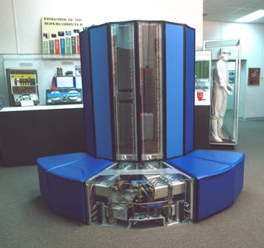
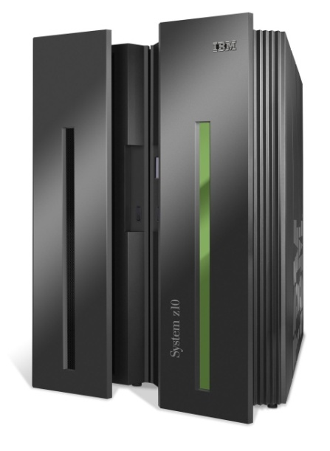

Slide 37
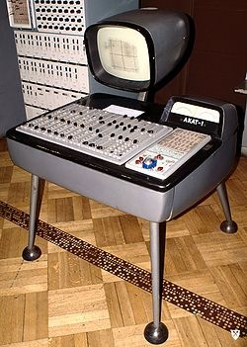
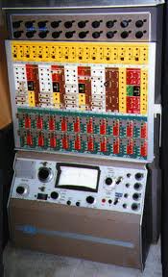
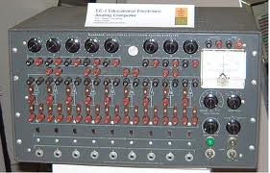
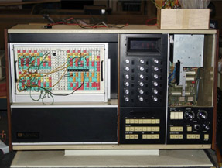

Slide 38
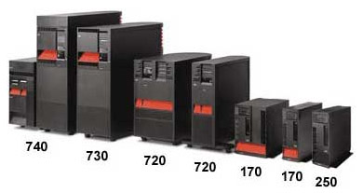
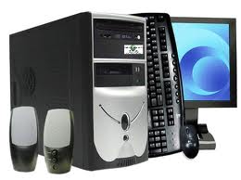
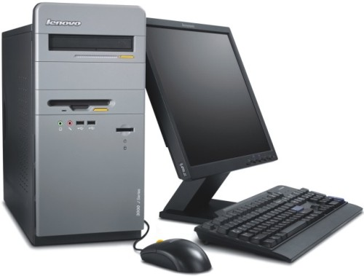

Slide 39
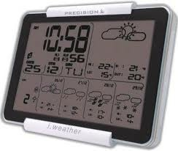
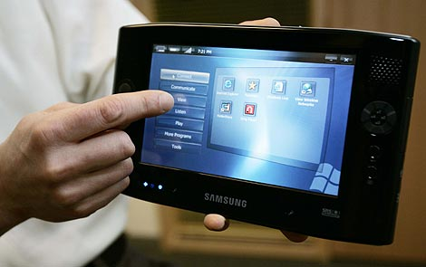
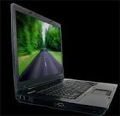

Slide 40
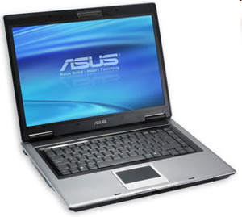
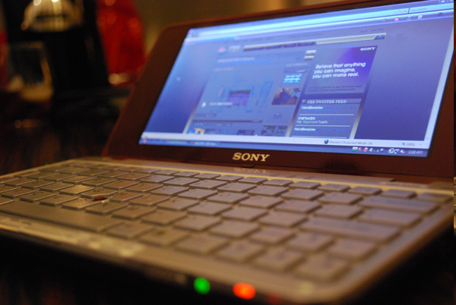
Desktop & Laptop

Slide 41
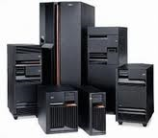
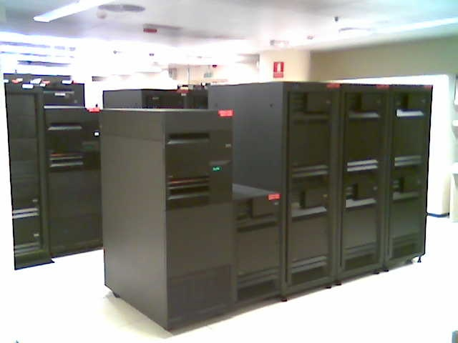
Small & Medium Computer

Slide 42

Small Micro Computer

Slide 43
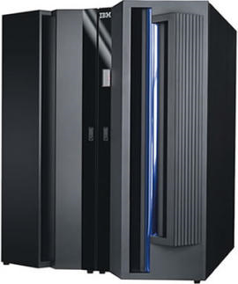
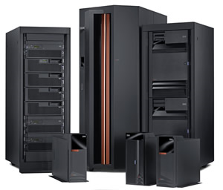
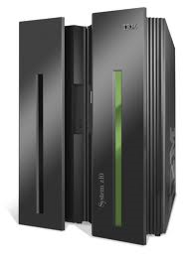
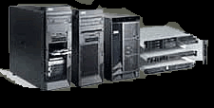
IBM Mainframe
IBM P Series
IBM Z Series
IBM Z Series
IBM X Series

Slide 44

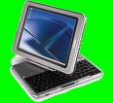
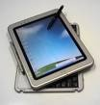
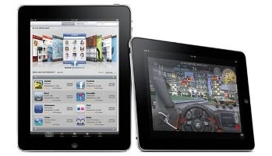
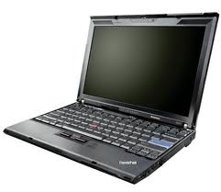
Modern Portable Computer

Slide 45
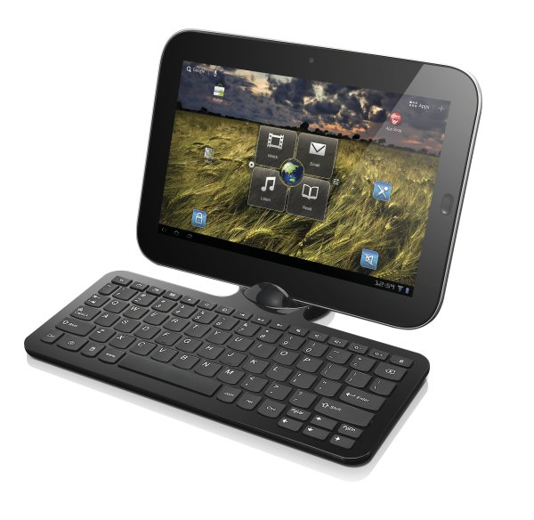
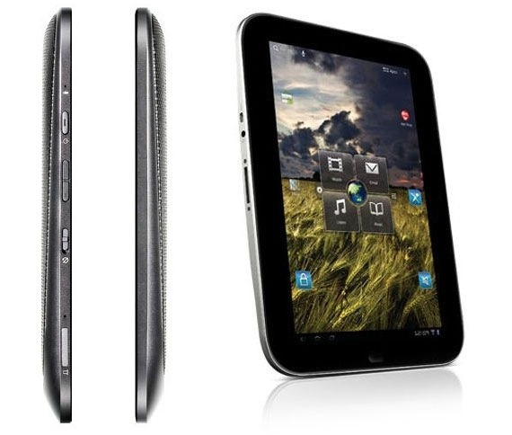
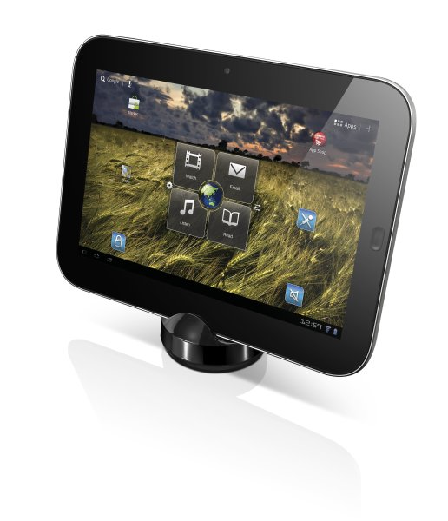
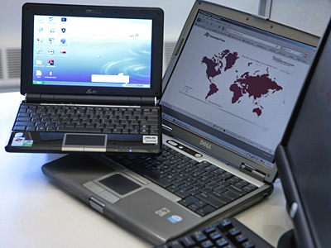
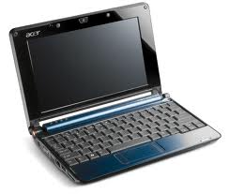
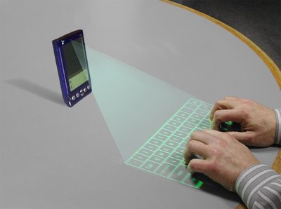
netbook

